Slide 1


Dayananda Sagar University
School of Engineering
Devarakaggalahalli, Harohalli Kanakapura Road, Dt, Ramanagara, Karnataka 562112
Department of Computer Science & Engineering
(Artificial Intelligence & Machine Learning)
FULL STACK DEVELOPMENT
Module-1
SEMESTER – IV

Slide 2

Topics
Introduction to HTML: Simple HTML Document Hyperlink Adding Image Style Attribute Paragraph Tag HTML Formatting Elements Comment Line CSS
Prepared by : Dr. M. Lakshmanan

Slide 3
HTML
What is HTML? HTML stands for Hyper Text Markup Language HTML is the standard markup language for creating Web pages HTML describes the structure of a Web page HTML consists of a series of elements HTML elements tell the browser how to display the content HTML elements label pieces of content such as "this is a heading", "this is a paragraph", "this is a link", etc.
Prepared by : Dr. M. Lakshmanan

Slide 4
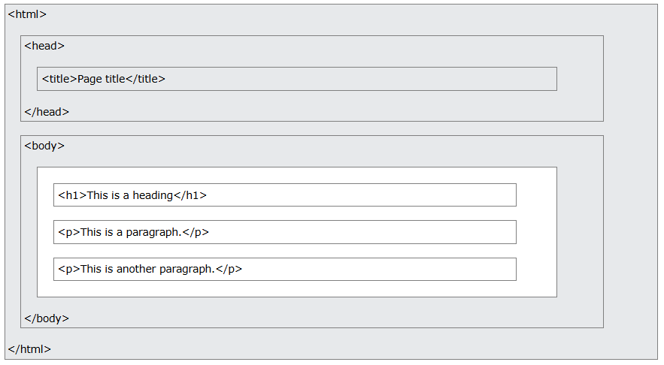
HTML Page Structure

Slide 5
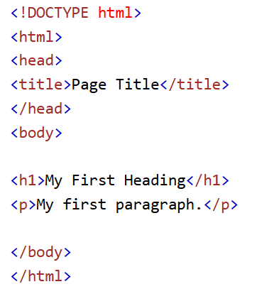
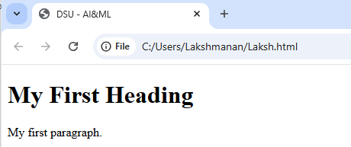
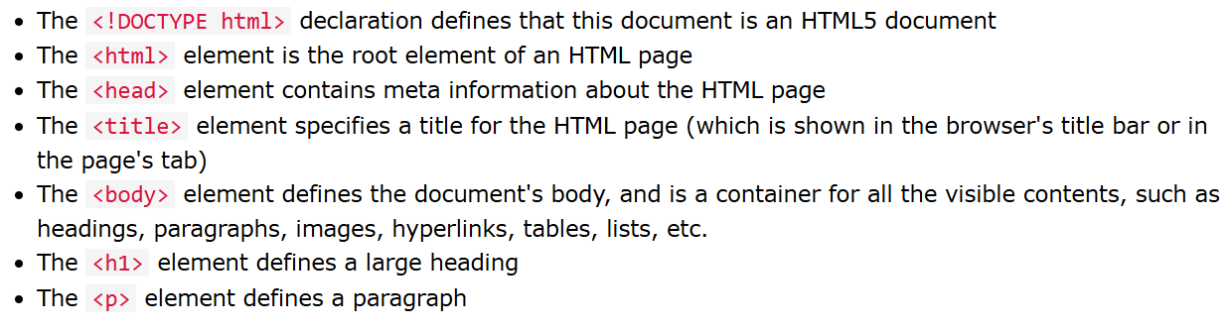
A Simple HTML Document

Slide 6
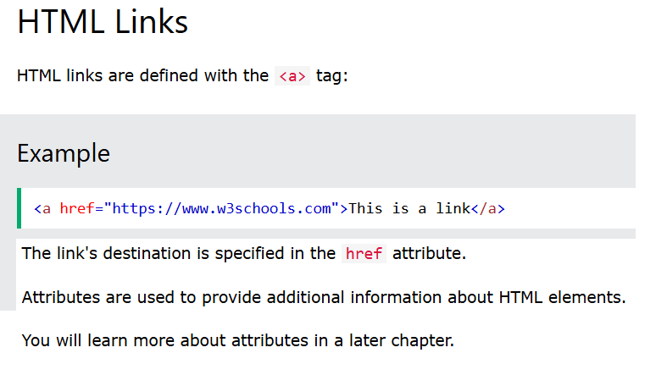
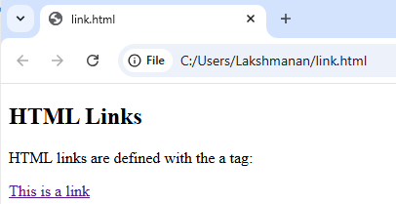
Hyperlink

Slide 7
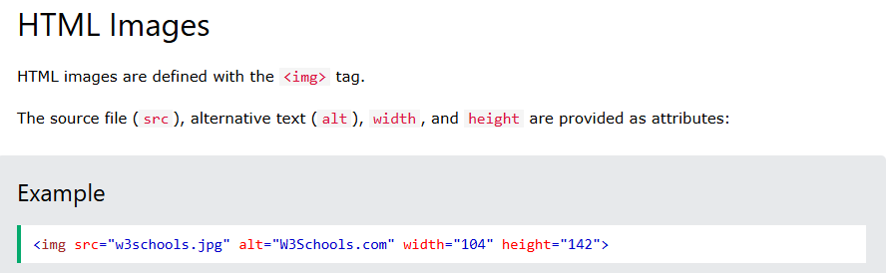
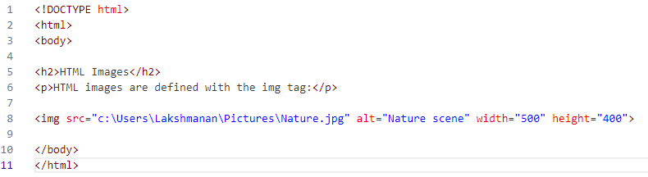
Adding Image

Slide 8
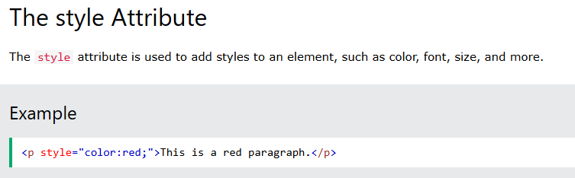
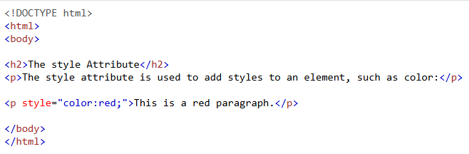
Style Attribute

Slide 9
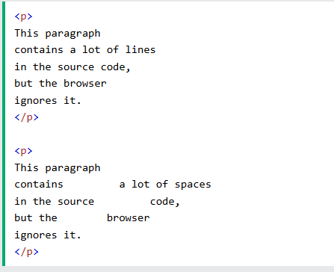
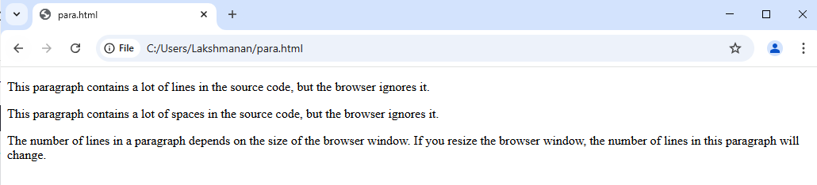
Paragraph Tag

Slide 10
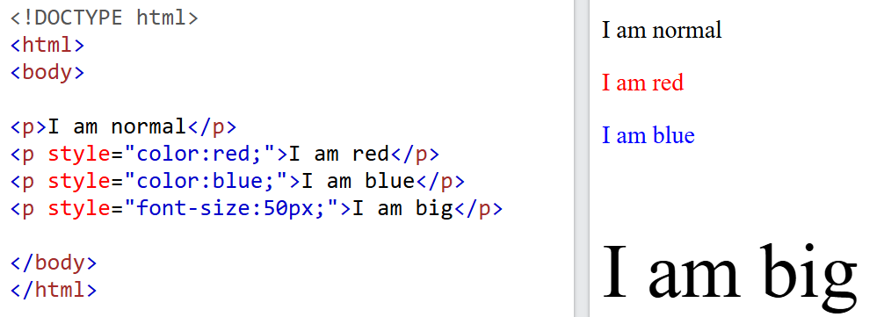
Style Attribute

Slide 11
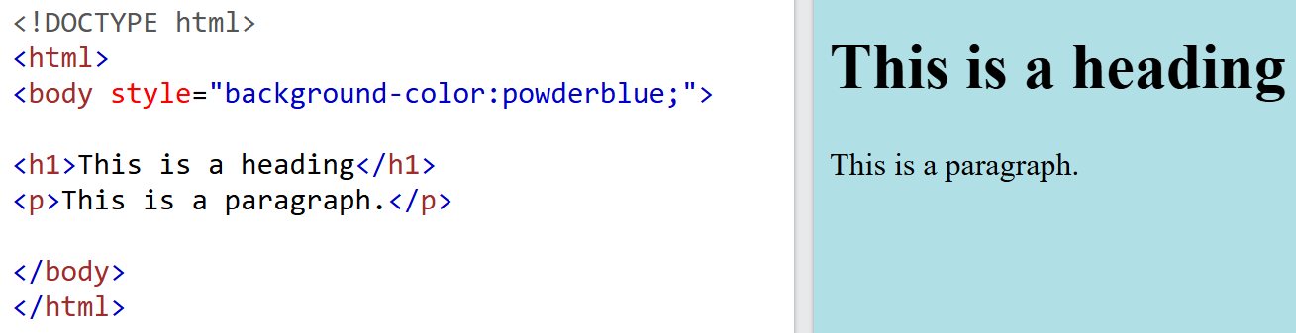
Style Attribute

Slide 12
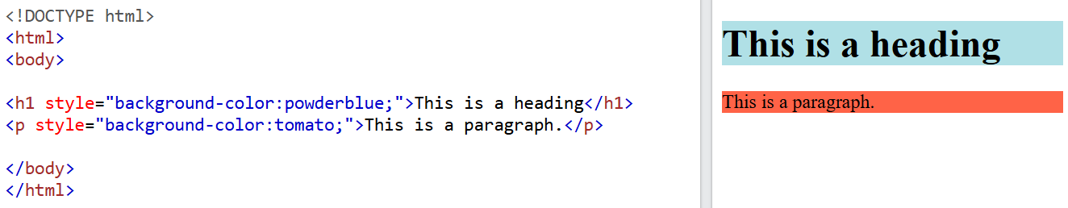
Style Attribute

Slide 13
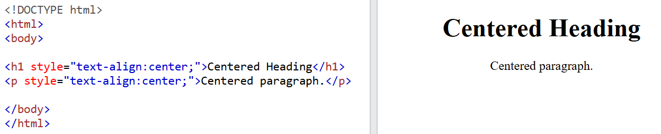
Style Attribute

Slide 14
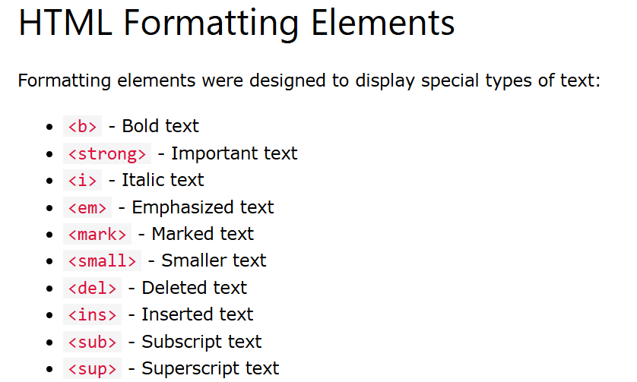
Formatting Elements

Slide 15
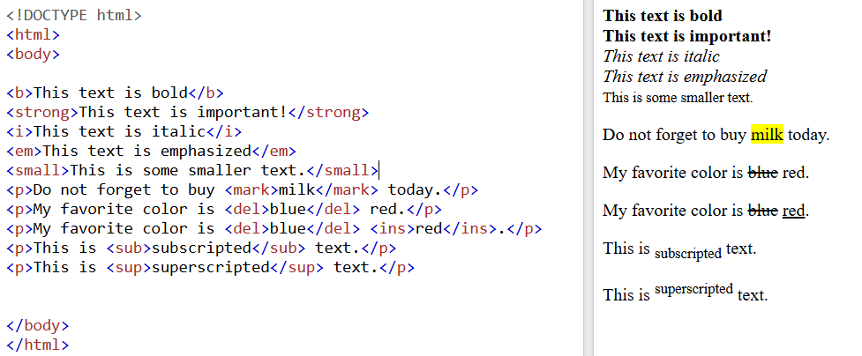
Formatting Elements

Slide 16
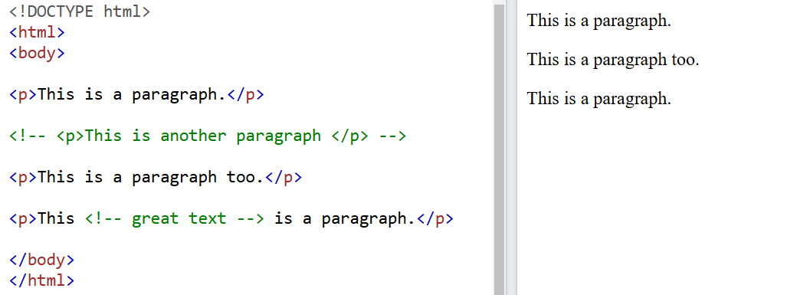
Comment Line

Slide 17
Task -2
<!DOCTYPE html>
<html lang="en">
<head>
<meta charset="UTF-8">
<title>Student Task - Styling with HTML</title>
</head>
<body>
<!-- Task 1: Change the text color to blue -->
<p style="color: red;">This is AIML dept</p>
<!-- Task 2: Increase the font size to 24px -->
<p style="font-size: 16px;">USN: ABCDEFGHI</p>
<!-- Task 3: Add a yellow background to this paragraph -->
<p style="background-color: yellow">Describe yourself</p>
<!-- Task 4: Center align the text inside this paragraph -->
<p style="text-align: left;">Full Stack Development</p>
<!-- Task 5: Use multiple styles (color: green, font-size: 22px, background-color: lightgray, text-align: center) -->
<p style="color: black; font-size: 18px; background-color: white; text-align: left;">
Playing, cricket</p>
</body>
</html>
Notes:
This is the opening HTML tag that defines the start of an HTML document.
lang="en":
This attribute specifies the language of the webpage content.
"en" stands for English.

Slide 18
Task-01
Design a Personal Webpage for a Hobbyist
You are tasked with designing a simple personal webpage for a hobbyist who loves photography. The webpage should include the following elements:
A title for the page that introduces the hobbyist’s passion.
A hyperlink that directs users to a photography blog they follow.
An image of a camera, as the hobbyist enjoys photography.
A styled paragraph that includes a brief introduction to the hobbyist’s interests.
A few HTML formatting elements to emphasize certain words and make the webpage visually engaging.
A comment line to indicate a section where the user can add their favorite photography quotes later.
Requirements:
Use the <style> attribute to style the page background color and text color.
Use the <p> tag to write a short paragraph about the hobbyist’s interests.
Use <strong>, <em>, and <u> to emphasize certain parts of the text.
The page should be simple and easy to read.

Slide 19
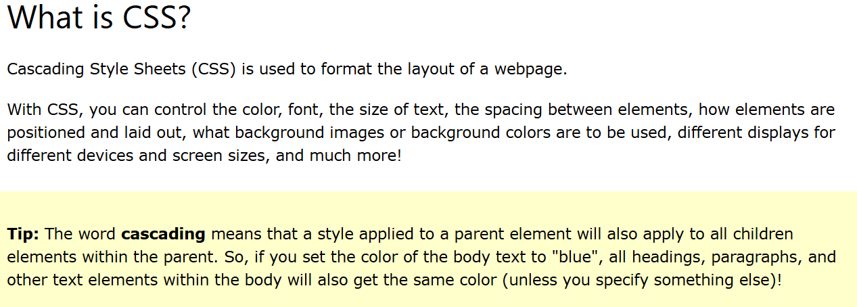
CSS

Slide 20
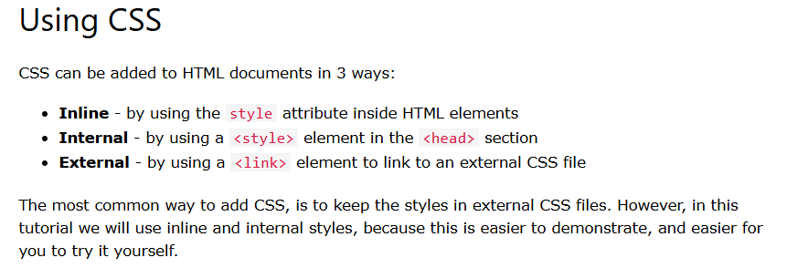
CSS

Slide 21
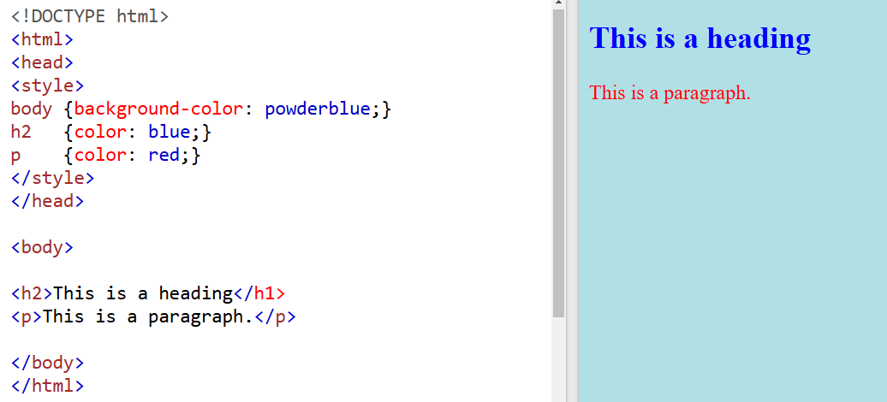
Internal CSS

Slide 22
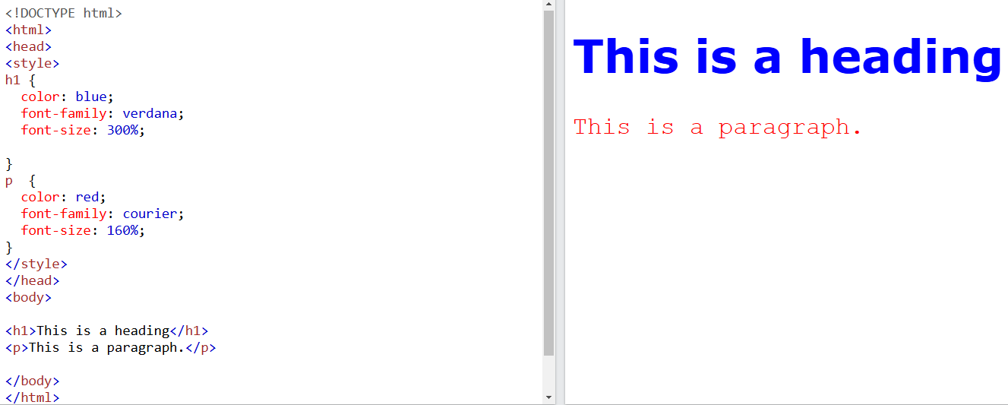
Internal CSS

Slide 23
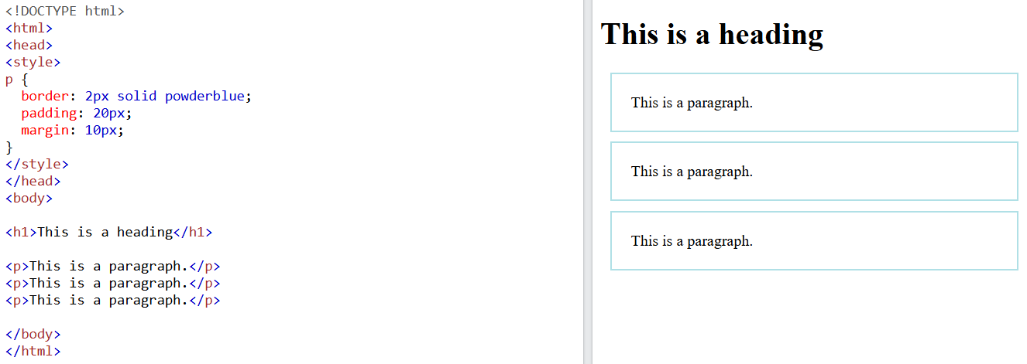
Internal CSS: Margin, Border, Padding

Slide 24
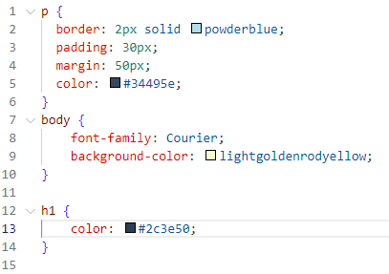
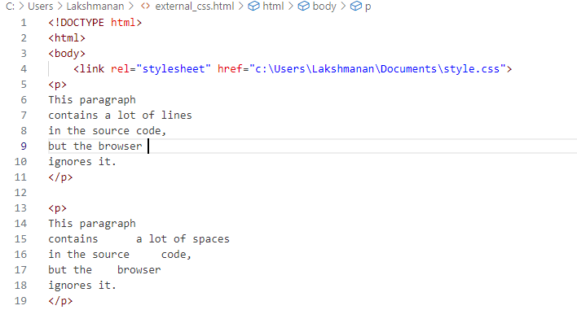
External CSS

Slide 25
Task-02
You have been assigned to design a simple webpage for a local bakery called "Sweet Treats." The webpage should include the following:
A title header displaying the bakery name "Sweet Treats" at the top of the page.
A short introduction about the bakery with a paragraph describing the specialties.
A list of three popular bakery items with prices.
An image of the bakery or its products (you can use a placeholder image).
A footer with the text "Visit Us Today!" and the bakery's location.
The webpage should be designed using basic HTML tags like headings, paragraphs, lists, images, and a footer. Apply simple CSS for styling the page to make it visually appealing.
Requirements:
The page should have a clean layout with a pleasant background color.
The title should be large and centered.
The introduction text should be smaller and aligned to the left.
The list of bakery items should have a neat design with item names and prices.
The footer text should be centered at the bottom of the page.

Slide 26
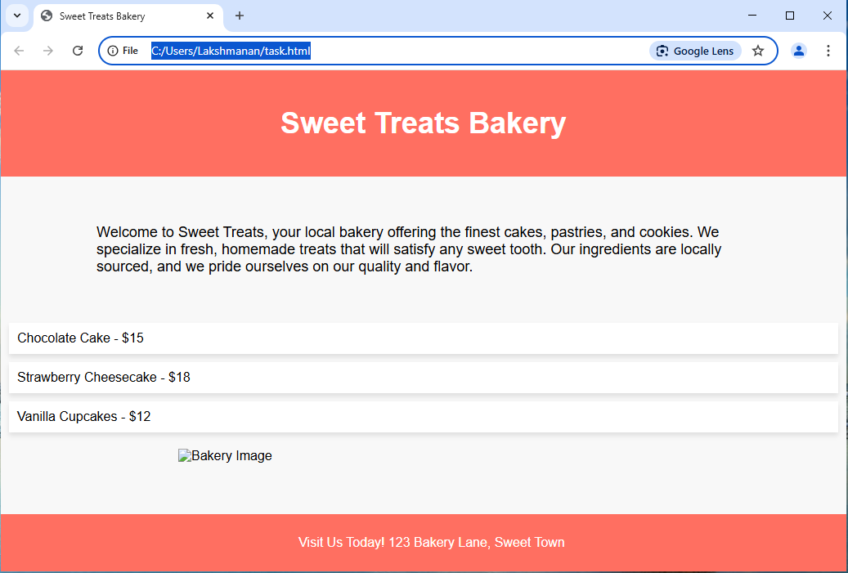
Task-02 Sample Output

Slide 27

Thank You

